Slide 1

RAISING FROM THE PAC & MEMBER COMMUNITY
The Basics & FEC Rules
Targeting & Messaging
How to Get a PAC check
Expectations
Tools
Relationship Building & Maintenance
Member $$
How the DCCC can help!

Slide 2
PAC to the Basics
What is a Political Action Committee?
A group of individuals with a common interest
  Labor Groups, Trade Associations, etc.
Collective financial resources to support a candidate or another committee
Federal, State and Local
Over 5,000 registered with the FEC
A potential source of money for your campaign
Notes:
ARE ANY OF YOU ON STATE OR LOCAL RACES?

Slide 3
PAC-ceptable Contributions
  $5k per election from a Multi-Candidate PAC
    This includes most PACS and some Leadership PACs
  $2.7k per election from a Non-Multi-Candidate PAC
    This includes some PACs and some Leadership PACs
  $5k from your State Party each year
    This is annually, not cycle and counts against your in-kinds.
  $2k from a Member’s re-elect committee per election ($2k each for Primary and General)
  $1k from any non-federal campaign committee per year (need FEC letter)
Often Local affiliates have their own PAC that is affiliated with their national organization. If it is not a PAC registered with the FEC you can not take the check.
If the PAC is registered with the FEC – remember it aggregate with their national counterpart.

Slide 4
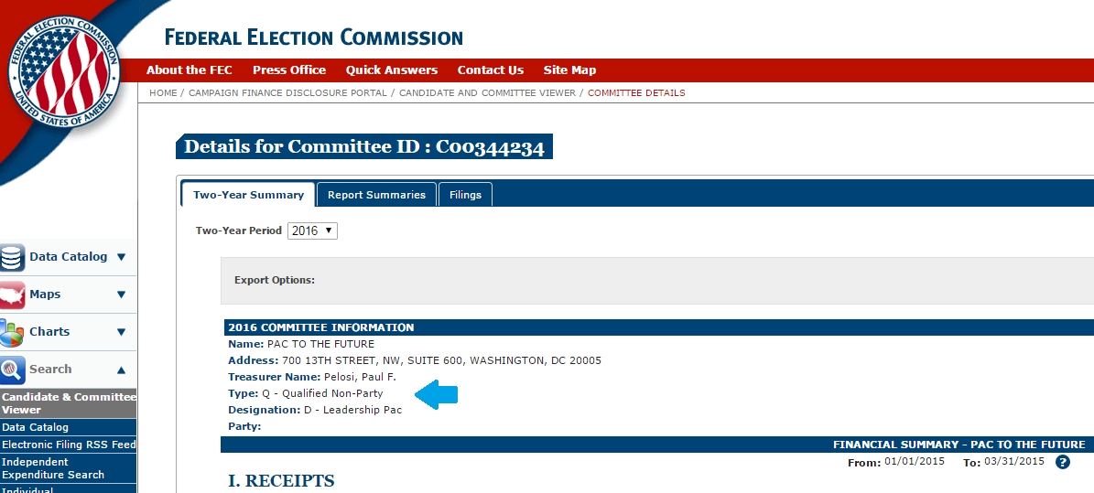
PAC-tically speaking, how do I tell?
How to distinguish a Multi-Candidate PAC from a Non-Multi-Candidate PAC
Go the www.fec.gov
Type in the PAC name
Look at Type under Committee Information

Slide 5
PAC to the Beginning
Where to Start
Where do I start when raising PAC contributions?
Local
Local
Local

Slide 6
Un-PACing Contributions
Labor and Single Issue PACS
START EARLY!
Find out where candidate stands on the PAC’s issues before you solicit a PAC.
Just like individual donors, a PAC needs a reason to contribute.
  Has your candidate ever held an elected position?
    How did they vote?
    Have they received past PAC $?
  Have you completed and returned their questionnaire?
Just like donors, PACs want to know you are running a strong campaign that will win. You must show viability.

Slide 7
Un-PACing Contributions
Associations & Industry PACS
What organizations does your candidate belong to and who does your candidate know?
  Look at occupation's & Employers of your candidate’s personal circle & donors (i.e. Dentist; Dermatologist; Funeral Home Director, Fire Fighter)
Set up meetings with Executive Directors/Chairs of State associations.
  You need to contact the local/state level affiliate first!
  The National organization will not cut you a PAC check unless you have reached out to your local first.
Find contributors to the PAC or Association you are trying to solicit.
  Some groups will support you if one of their PAC donors makes an ask!

Slide 8
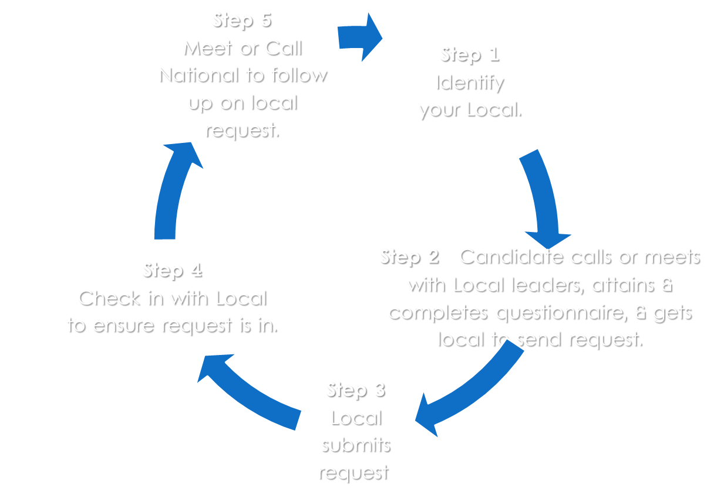
PAC it up, PAC it in

Slide 9
Creating a PAC mentality
Don’t just call them for a check! When events happen, update them.
  big endorsements? Good Polls? Out raising your opponent? Let them know!
Make sure both Locals and National are thanked after receiving checks.
Keep the PAC community informed by sending bi-monthly campaign updates to full PAC community.
Invite them to small dollar or industry specific events.
Leadership coming to your district? Add a Labor/Campaign briefing to the schedule and make sure to personally invite the locals.
Get your Locals in touch with your campaign manager and field director.

Slide 10
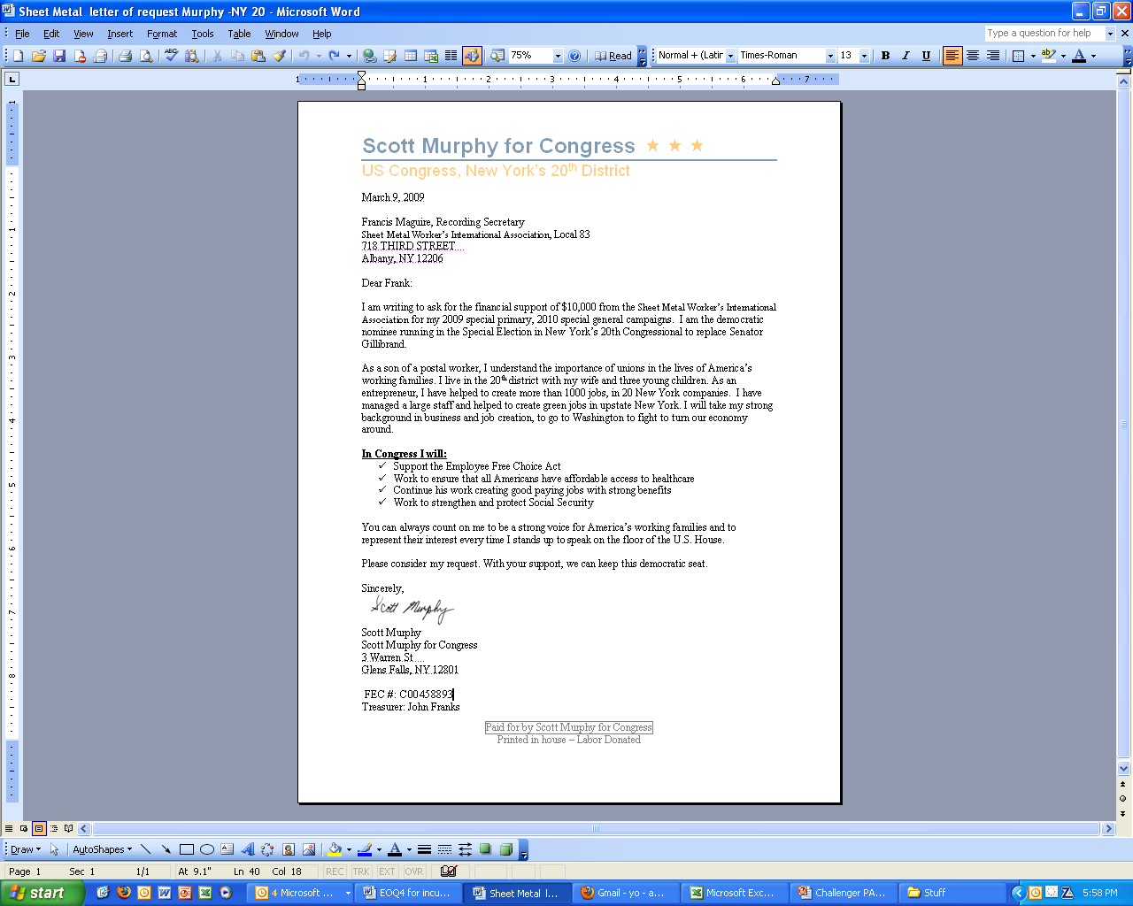
Care PACage: Request Letter
Important Information to Include:
FEC ID #
Committee Name
Treasurer
Address
If its to a union – union bug or “Printed in house”
Why they should support your candidate

Slide 11
Care PACage: Prospectus
A PAC Prospectus can include:
Candidate Bio
Polling Memo
Endorsements
District Demographics
Positive Quotes
FEC ID Number & Campaign Committee Vitals
Recent Positive Press Clips
Notes:
HAND OUT MCCASKILL PAC PROSPECTUS

Slide 12
Member Money
Does your candidate have a personal connection to any current or former members?
Your own Delegation
  Is there someone in Leadership?
  Don’t forget your Senators
Members in your Region
Members on your Committees
  Will they do floor cards?
  Will the Ranking Member make calls or host an event for your candidate?
Members that have the same ideology or ethnicity

Slide 13
ExPACtations
No one is entitled to DC money. Money you receive out of DC will be based on your Candidates background, relationships built within your State and the credibility of their Candidacy.
PAC and Member money comes in late – you can count on the majority of it coming before your primary and in the last few weeks of the general election.
Because everyone is at different stages with building a PAC plan – consult your DCCC Regional when targeting out PAC and Member money for the quarter.
The stronger relationship you build with your Local, the harder they will push their nationals in DC to support.

Slide 14
ExPACtations
When you’re in DC, meet with DC PAC folks
  The DCCC can help you with your fly-ins
  Do your research before you meet with DC folks
Friendly Incumbent Rule
  Many PACs have a friendly incumbent rule
  If an incumbent is good/neutral on their issues, they won’t give to a candidate.
Don’t make assumptions
  Never make an assumption about a PAC

Slide 15
How the DCCC Can Help
PAC Workbook
Targeting out PACs & Members that fit your Candidate & District
Obtaining & Reviewing Questionnaires
Keep your DCCC Regional informed on where you are with the process
Recommending PAC Consultants – when & if your campaign is ready

